Slide 1

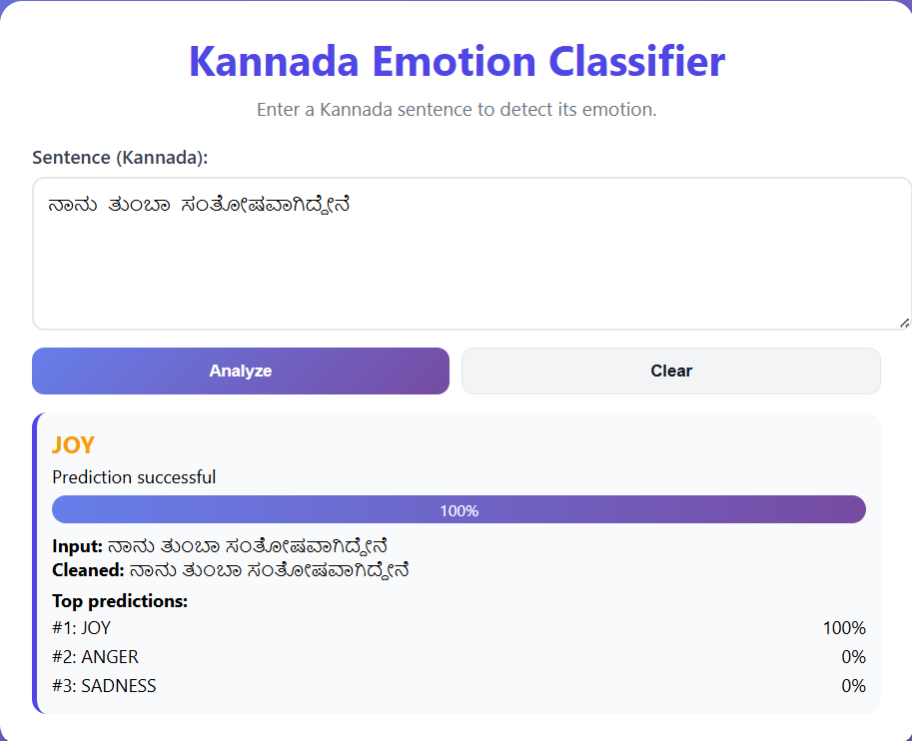
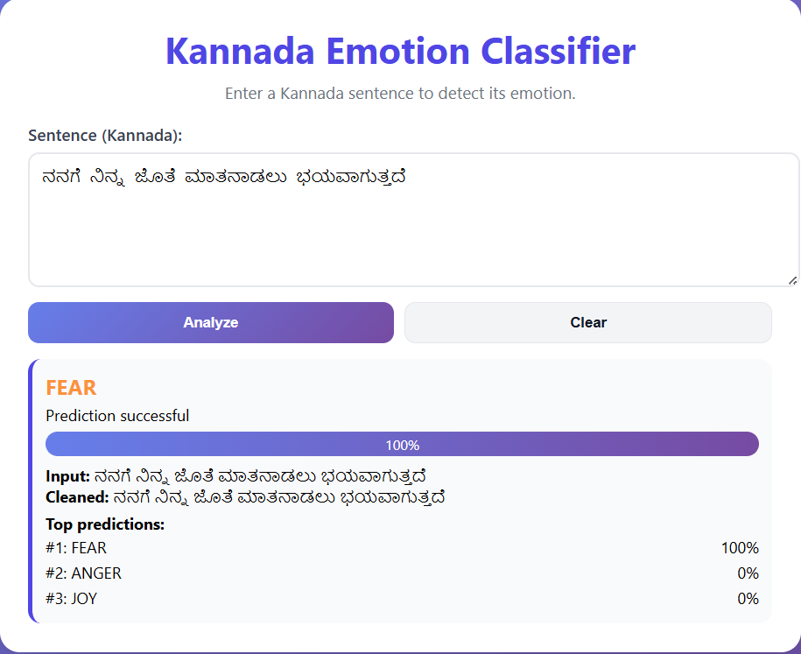
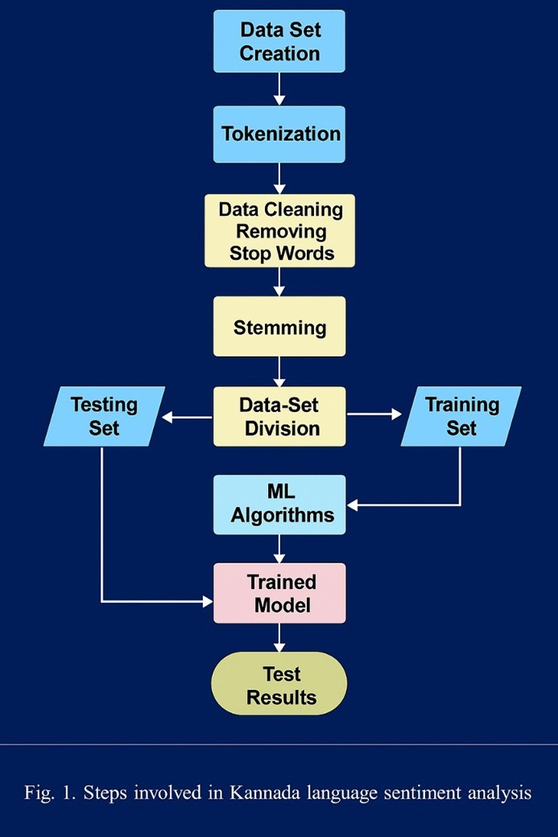
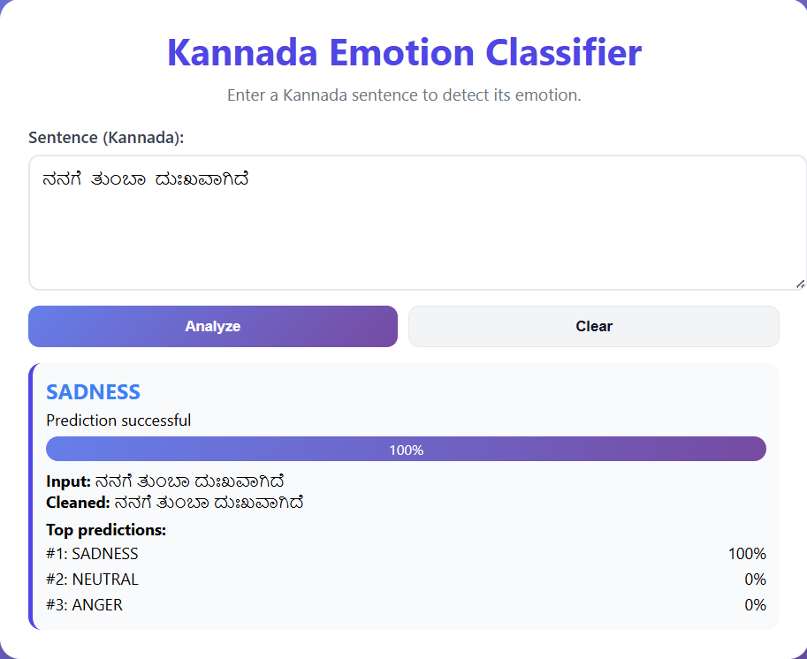
YENEPOYA INSTITUTE OF TECHNOLOGY
Project Exhibition
Dec-2025
Thodar, Moodbidri – 574225, Mangalore, D.K
Department of Information Science and Engineering
“Developing XLM-RoBERTa Sentiment Analysis Models for Kannada: Addressing Low-Resource Language”
_{GROUP MEMBERS NAME AND USN}
_{NAVEEN KATTI – 4DM23IS031}
NIKITH N - 4DM23IS032
_{PREM GOUDA – 4DM23IS035}
_{SUMANTH T P – 4DM23IS056}
Guided by:
Prof.Manish Prajapati
ABSTRACT
System: “Kannada sentiment Analysis Model" – A Kannada Emotion Classification System.
Tech: Powered by XLM-Roberta for high accuracy.
Emotions: Detects Joy, Sadness, Anger, Fear, and Neutral.
Goal: Solves the lack of regional NLP tools using a custom dataset.
Usage: Real-time web UI for customer support and sentiment analysis.
Introduction
Emotion recognition is vital for AI-human interaction. While English tools abound, Kannada lacks robust resources. This project fine-tunes the XLM-Roberta model on a curated dataset of 10,000+ Kannada sentences. It goes beyond literal translation to capture emotional nuance, enabling applications in mental health monitoring and social media analysis for Karnataka's population.
METHODOLOGY
Data:Curated 10k+ labeled Kannada sentences.
Augmentation: Generated synthetic data using keywords (e.g., "ಹಸಿವು", "ಕೆಟ್ಟ") to balance classes and improve short-text accuracy.
Model:Architecture: XLM-Roberta-Base (Pre-trained Multilingual Transformer).
Training: Fine-tuned for 3 epochs (AdamW optimizer, Cross-Entropy Loss).
Deployment:
Backend: Python & PyTorch.
Frontend: Flask Web App with a responsive UI.
Proposed Method
Model: Uses XLM-Roberta for robust multilingual support.
Tokenizer: Applies SentencePiece to handle Kannada text structure.
Training: Fine-tunes the base model on a custom augmented dataset.
Output: Classifies text into 5 emotions via a dense layer.
Optimization: Uses AdamW and Cross-Entropy Loss for accuracy.
SYSTEM REQUIREMENTS
Hardware: Intel i5+, 8GB RAM, NVIDIA GPU (Optional for inference).
Software: Windows/Linux, Python 3.8+, PyTorch, Transformers, Flask.
SNAPSHOTS
CONCLUSION
The "Kannada Emotion Classifier" successfully demonstrates the power of transfer learning for regional languages. By fine-tuning XLM-Roberta, we achieved state-of-the-art performance in detecting emotions from Kannada text. The system is robust, handling various sentence lengths and vocabulary effectively. The web-based deployment ensures that this technology is accessible and usable, marking a significant step forward in Kannada NLP.
FLOWCHART
RESULTS
Accuracy: Achieved ~99% accuracy on test data.
Performance: High confidence on short phrases (e.g., "ನನಗೆ ಖುಷಿ" Joy: 99%).
FUTURE WORK
Speech Integration: Add Speech-to-Text for voice input.
More Emotions: Expand to include Surprise, Disgust, etc.
Mobile App: Develop a standalone Android/iOS application.

